Slide 1

Subject Code: SCSA1403 Subject Name: Design and Analysis of Algorithms UNIT III Faculty Name: Dr. P. AJITHA

Slide 2
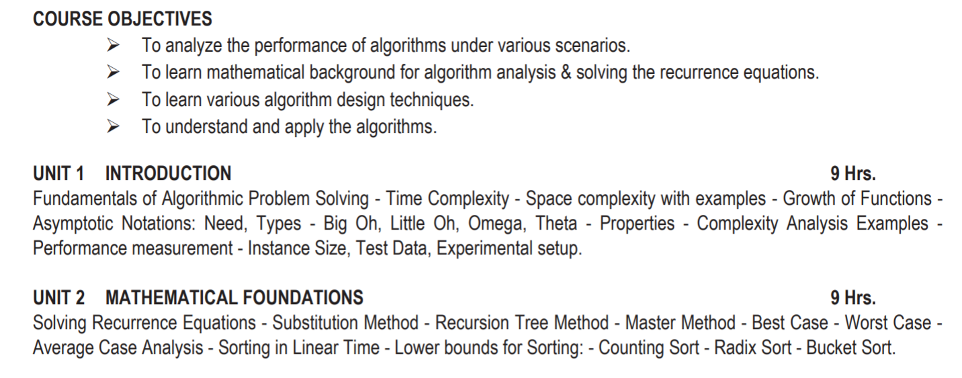

Slide 3
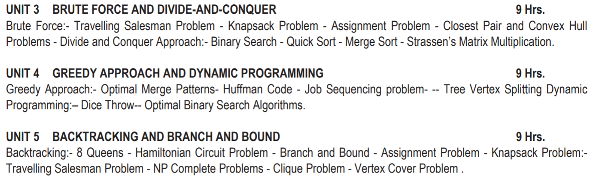

Slide 4
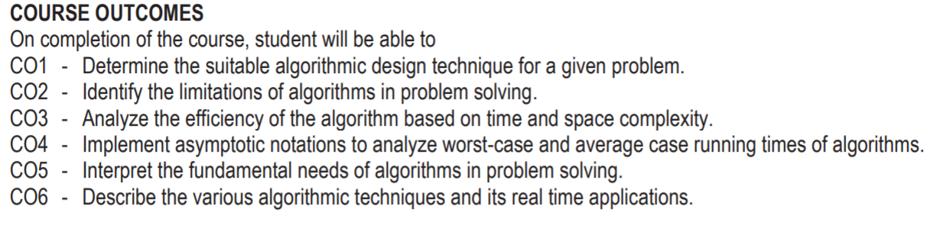

Slide 5
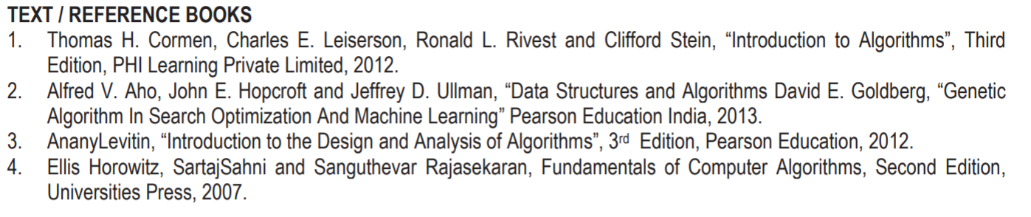

Slide 6
Road Map to Unit III
BRUTE FORCE AND DIVIDE-AND-CONQUER 9 Hrs.
Brute Force:- Travelling Salesman Problem - Knapsack Problem - Assignment Problem - Closest Pair and Convex Hull
Problems - Divide and Conquer Approach:- Binary Search - Quick Sort - Merge Sort - Strassen’s Matrix Multiplication.

Slide 7
BRUTE FORCE
A Brute Force Algorithm is the straightforward approach to a problem i.e., the first approach that comes to our mind on seeing the problem. More technically it is just like iterating every possibility available to solve that problem.
“Force” comes from using computer power not intellectual power
For Example: If there is a lock of 4-digit PIN. The digits to be chosen from 0-9 then the brute force will be trying all possible combinations one by one like 0001, 0002, 0003, 0004, and so on until we get the right PIN. In the worst case, it will take 10,000 tries to find the right combination.

Slide 8

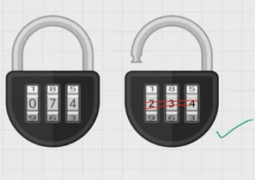
BRUTE FORCE
Eg. Padlock: Rubik

Slide 9
BRUTE FORCE
Strengths
Most of the practical problems apply this approach
Simple
Results in acceptable algorithms for some important problems like matrix multiplication, sorting, searching and string matching
Weaknesses
Algorithms cannot be guaranteed as efficient
Some of these algorithms are very slow
Useful only for instances of small size
Not as constructive as some other design techniques

Slide 10
BRUTE FORCE
Example 1:
Computing a^{n} (a > 0, n a nonnegative integer) based on the definition of exponentiation
a^{n =} a * a * a*.....*a
The brute force algorithm requires n-1 multiplications.
The recursive algorithm for the same problem, based on the observation that
a^{n} =a^{n/2} * a^{n/2} requires Θ (log (n)) operations.

Slide 11
Travelling Salesman Problem
A complete graph K_{N} is a graph with N vertices and an edge between every two vertices.
A weighted graph is a graph in which each edge is assigned a weight (representing the time, distance, or cost of traversing that edge).
Example:
Given n cities with known distances between each pair, find the shortest tour that passes through all the cities exactly once before returning to the starting city.
To solve TSP using Brute-force method we can use the following steps:
Step 1. Calculate the total number of tours
Step 2. Draw and list all the possible tours
Step 3. Calculate the distance of each tour
Step 4. Choose the shortest tour, this is the optimal solution

Slide 12
Travelling Salesman Problem
Solution to TSP by Exhaustive approach
Tour Cost
a→b→c→d→a 2+3+7+5 = 17
a→b→d→c→a 2+4+7+8 = 21
a→c→b→d→a 8+3+4+5 = 20
a→c→d→b→a 8+7+4+2 = 21
a→d→b→c→a 5+4+3+8 = 20
a→d→c→b→a 5+7+3+2 = 17
Efficiency: Θ((n-1)!)

Slide 13
Knapsack Problem
Given some items, pack the knapsack to get the maximum total value. Each item has some weight and some value. Total weight that we can carry is no more than some fixed number W. So we must consider weights of items as well as their values.
There are two versions of the problem:
1. “0-1 knapsack problem”. Items are indivisible; you either take an item or not.
2. “Fractional knapsack problem”. Items are divisible: you can take any fraction of an item

Slide 14

Knapsack Problem
0-1 Knapsack Problem
1. Given a knapsack with maximum capacity W, and a set S consisting of n items
2. Each item i has some weight wi and benefit value vi (all wi and W are integer values)
3. Problem: How to pack the knapsack to achieve maximum total value of packed items?
Problem, in other words, is to find
The problem is called a “0-1” problem, because each item must be entirely accepted or rejected.

Slide 15
Knapsack Problem
Given n items:
• weights: w1 w2 … wn
• values: v1 v2 … vn
• a knapsack of capacity W
Find most valuable subset of the items that fit into the knapsack
Example: Knapsack capacity W=16
item weight value
1 2 $20
2 5 $30
3 10 $50
4 5 $10

Slide 16
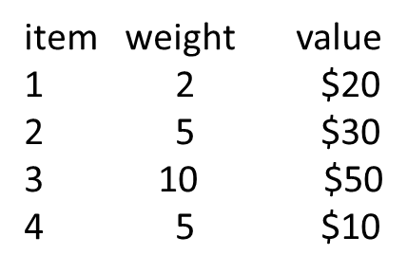
Subset Total weight Total value
{1} 2 $20
{2} 5 $30
{3} 10 $50
{4} 5 $10
{1,2} 7 $50
{1,3} 12 $70
{1,4} 7 $30
{2,3} 15 $80
{2,4} 10 $40
{3,4} 15 $60
{1,2,3} 17 not feasible
{1,2,4} 12 $60
{1,3,4} 17 not feasible
{2,3,4} 20 not feasible
{1,2,3,4} 22 not feasible
Efficiency: Θ (2^n)

Slide 17
Assignment Problem
Let us consider that there are n people and n jobs. Each person has to be assigned only one job. When the jth job is assigned to pth person the cost incurred is represented by C.
C=C[p,j]
Where, p=1,2,3......n
J=1,2,3.......n
The number of permutations(the number of different assignments to different persons) is n!
The exhaustive search is impractical for large value of n.

Slide 18
Assignment Problem
Let us consider 4 persons(P1,P2,P3 and P4) and 4 jobs(J1,J2,J3 and J4).
Here n=4.
Here the number of possible and different types of assignment is 4!
n! = 4!
=4 x 3 x 2 x 1
=24

Slide 19
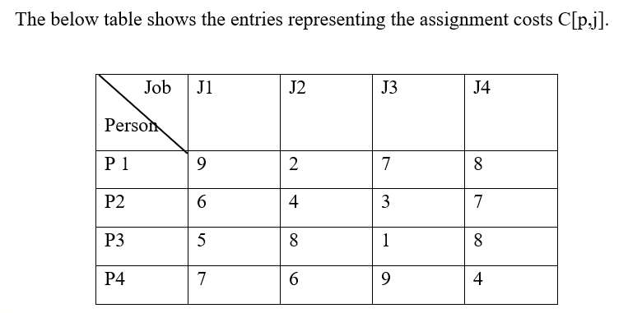
Assignment Problem

Slide 20
Assignment Problem
Iterations of solving the above assignment problem are given below. Here 4 persons indicated by P1,P2,P3 and P4; Similarly 4 jobs are indicated by J1,J2,J3 and J4.
Let us consider that the assignments can be grouped into 4 groups.
In the first group J1 is assigned to person P1. The remaining jobs J2, J3 and J4 are assigned to persons P2, P3 and P4. The number of ways in which these three jobs can be assigned to three persons is 3!(3!=6).

Slide 21
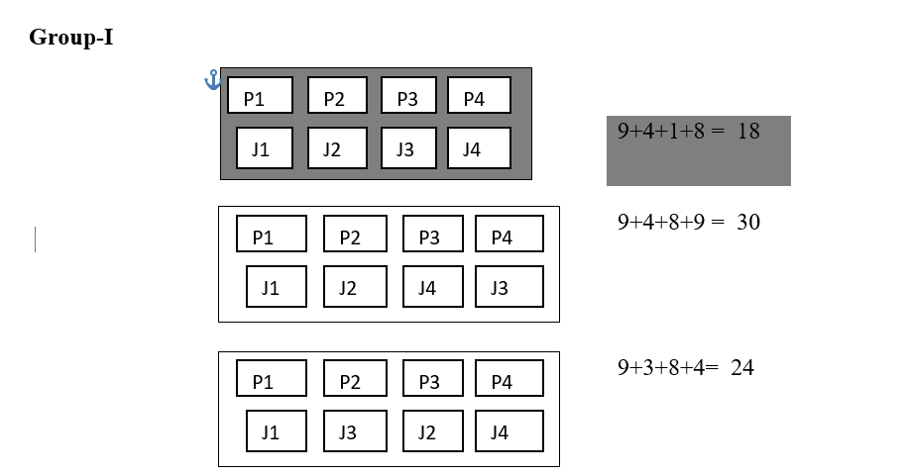
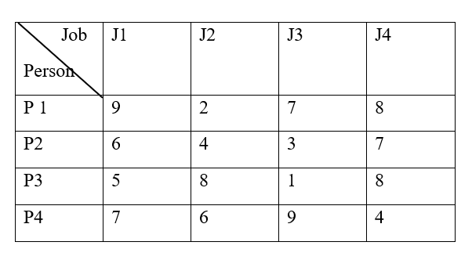
Assignment Problem

Slide 22
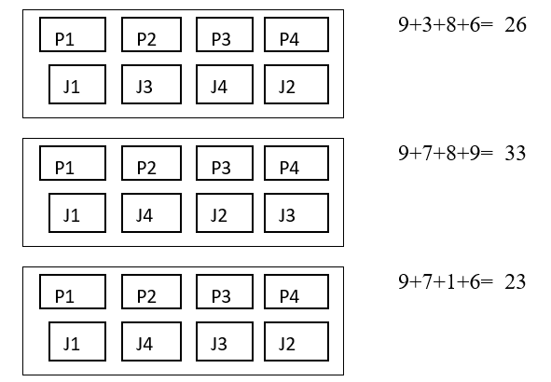
Assignment Problem

Slide 23
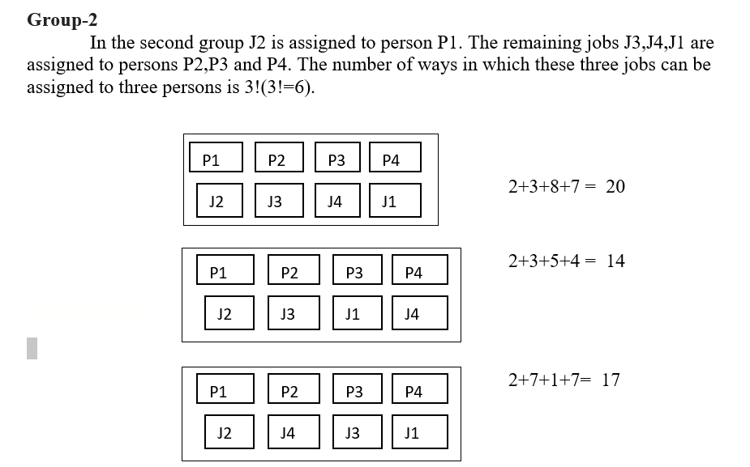
Assignment Problem

Slide 24
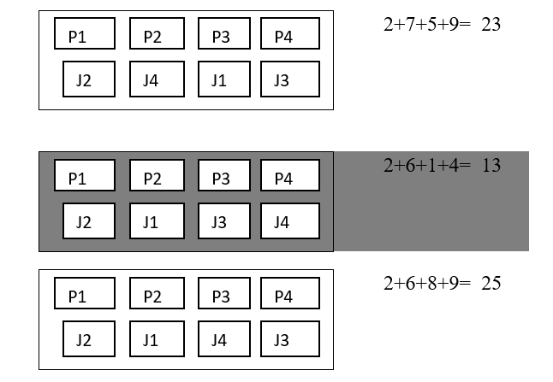
Assignment Problem

Slide 25
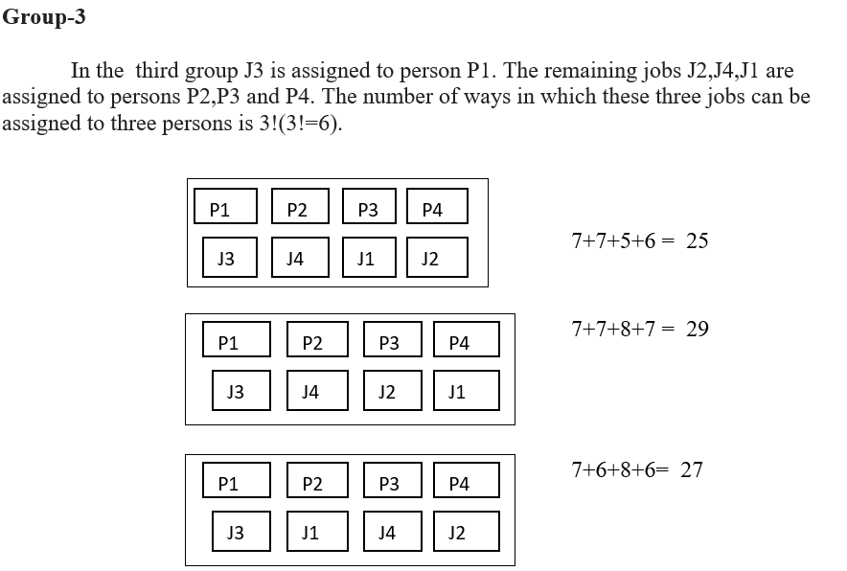
Assignment Problem

Slide 26
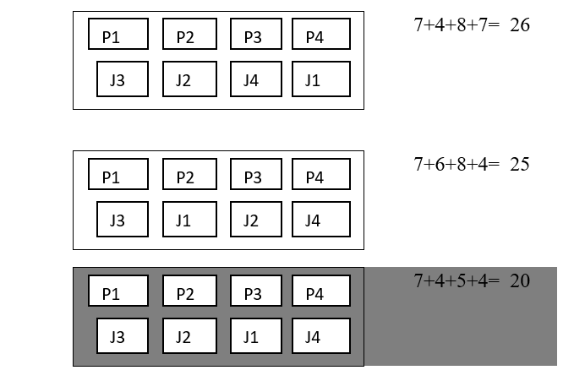
Assignment Problem

Slide 27
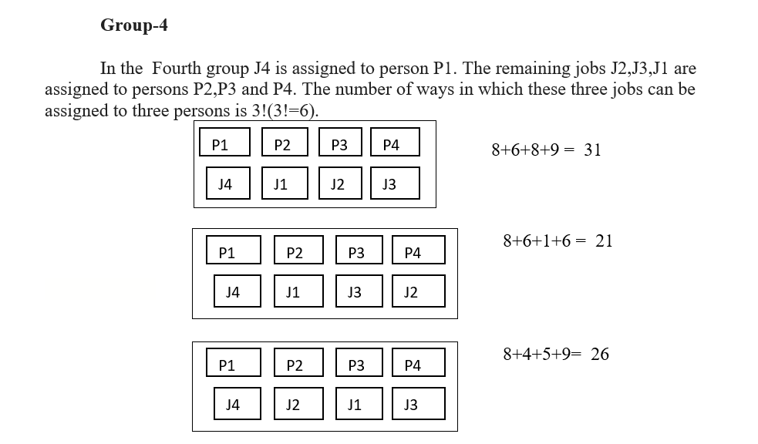
Assignment Problem

Slide 28
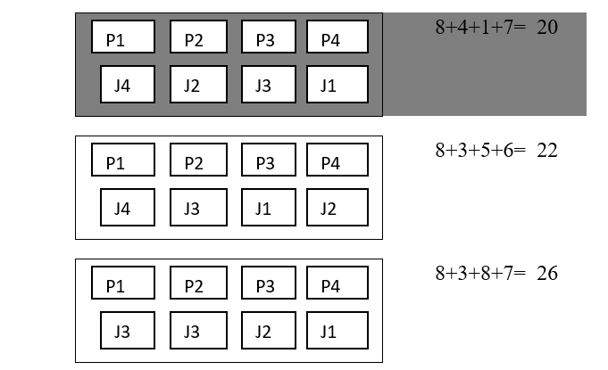
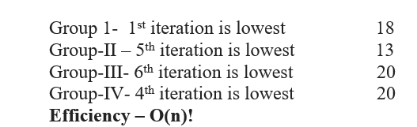
Assignment Problem

Slide 29
CLOSEST PAIR ALGORITHM
Given n points in the plane, find a pair with smallest Euclidean distance between them. When brute force method is used, it is required to check all pairs of points p and q with Θ(n²) comparisons.
Euclidean distance d(P_{i}, P_{j}) = Sqrt[(x_{i}-x_{j})² + (y_{i}-y_{j})²]
Find the minimal distance between a pairs in a set of points

Slide 30
CLOSEST PAIR ALGORITHM
Algorithm BruteForceClosestPoints(P)
// P is list of points
dmin ← ∞
for i ← 1 to n-1 do
for j ← i+1 to n do
d ← sqrt((x_{i}-x_{j})² + (y_{i}-y_{j})²)
if d < dmin then
dmin ← d; index1 ← i; index2 ← j
return index1, index2

Slide 31
CONVEX HULL PROBLEMS

Slide 32
CONVEX HULL PROBLEMS

Slide 33
CONVEX HULL PROBLEMS
Algorithm
for all points p in S
for all point q in S
if p!=q
Draw a line from p to q
If all points in S except p and q lie to the left of the line.
Add the directed vector pq to the solution set

Slide 34
Divide and Conquer Approach
The divide and conquer methodology is very similar to the modularization approach to software design.
Small instances of problem are solved using some direct approach.
To solve a large instance, we first divide it into two or smaller instances solve each of these smaller problems and combine the solutions of these smaller problems to obtain the solution to the original instance.
In Divide and Conquer approach ,we solve a problem recursively by applying 3 steps
1.DIVIDE-break the problem into several sub problems of smaller size.
2.CONQUER-solve the problem recursively.
3.COMBINE-combine these solutions to create a solution to the original problem.

Slide 35
Binary Search
Binary search method is very fast and efficient.
This method requires that the list of elements be in sorted order.
Binary search cannot be applied on an unsorted list.
Principle:
The data item to be searched is compared with the approximate middle entry of the list.
If it matches with the middle entry, then the position will be displayed.
If the data item to be searched is lesser than the middle entry, then it is compared with the middle entry of the first half of the list and procedure is repeated on the first half until the required item is found.

Slide 36
Binary Search
If the data item is greater than the middle entry, then it is compared with the middle entry of the second half of the list and procedure is repeated on the second half until the required item is found.
This process continues until the desired number is found or the search interval becomes empty.

Slide 37
ALGORITHM BINARYSEARCH(K, N, X)
// K is the array containing the list of data items
// N is the number of data items in the list
// X is the data item to be searched
Lower ← 0, Upper ← N-1
While Lower ≤ Upper
Mid ← ( Lower + Upper ) / 2

Slide 38
If (X < K[Mid])Then
Upper ← Mid -1
Else If (X>K[Mid]) Then
Lower ← Mid + 1
Else
Write(“ELEMENT FOUND AT”, MID)
Quit
End If
End If
End While
Write(“ELEMENT NOT PRESENT IN THE COLLECTION”)
End BINARYSEARCH

Slide 39
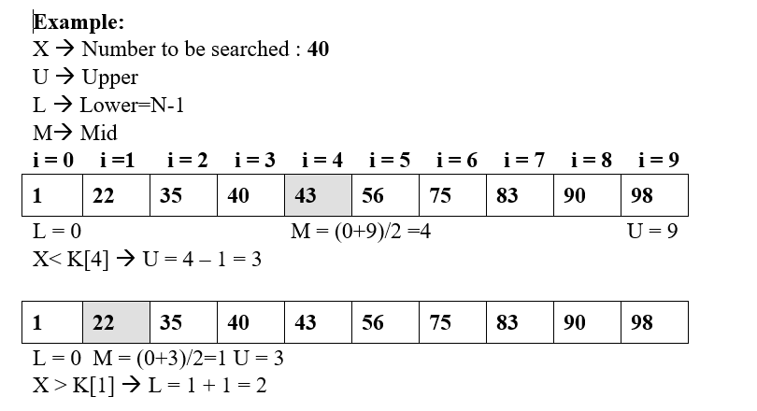

Slide 40
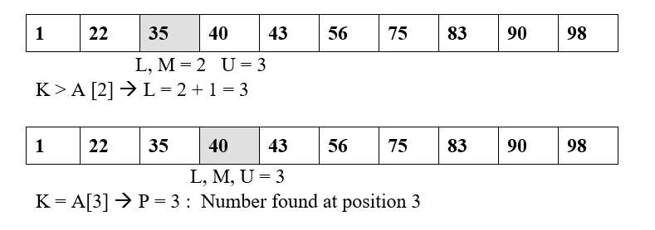

Slide 41
Advantages:
Searches several times faster than the linear search.
In each iteration, it reduces the number of elements to be searched from n to n/2.
Disadvantages:
Binary search can be applied only on a sorted list.

Slide 42
Advantages:
Searches several times faster than the linear search.
In each iteration, it reduces the number of elements to be searched from n to n/2.
Disadvantages:
Binary search can be applied only on a sorted list.

Slide 43
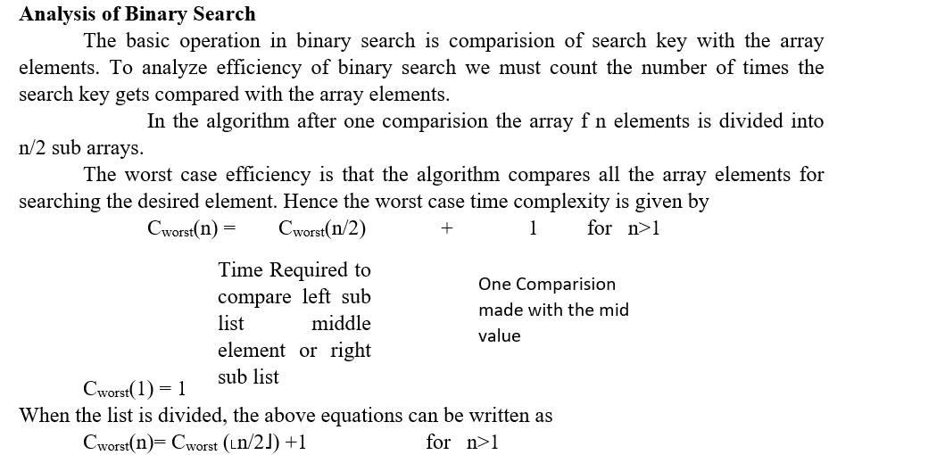

Slide 44
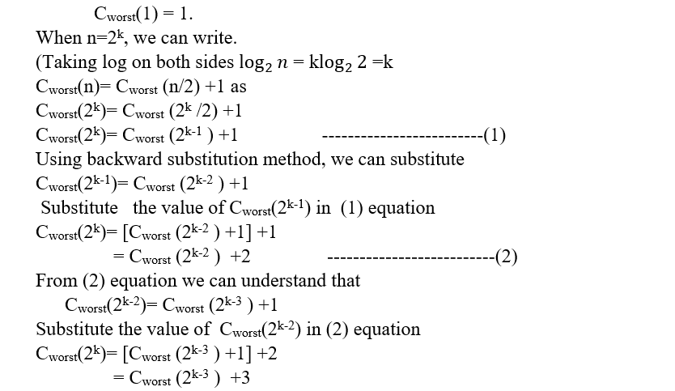

Slide 45
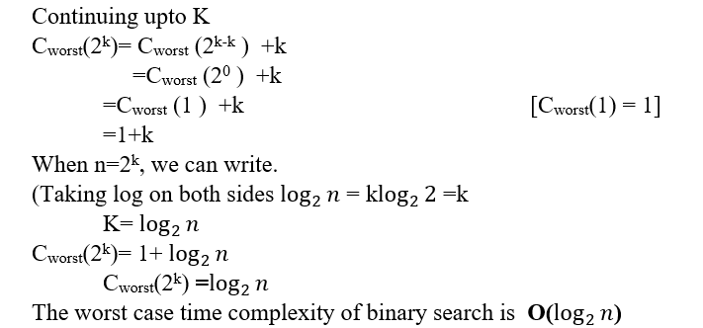

Slide 46
Strassen Matrix Multiplication
The Strassen’s method of matrix multiplication is a typical divide and conquer algorithm.
With strassens algorithm we can find the product of two 2 by 2 matrices with just seven multiplications.

Slide 47
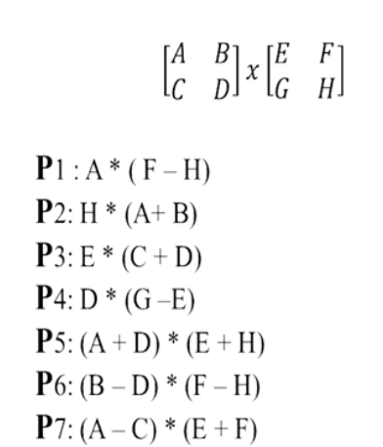
Strassen Matrix Multiplication

Slide 48
Strassen Matrix Multiplication

Slide 49
Quick Sort Analysis

